Slide 1
An introduction to Angular 2
Peter Messenger
Senior Developer at Kip Mc Grath Education Services
Email : stonecourier@gmail.com
Twitter: stonecourier
Website : www.petermessenger.com

Slide 2
My Development History
Lots of work with C#, HTML and JavaScript
Originally worked on webforms
Moved on Single Page applications (Knockout JS)
Worked on developing Silverlight Applications
Worked on MVC apps, JQuery front ends
Worked with Typescript extensively
Presented a coders on Windows Phone, Android, Silverlight, Knockout, MVVM, JQuery Mobile/UI Typescript, Nativescript + more

Slide 3
Application I am working on
Teaching portal, setting up and doing lessons collaboratively
Kids (5 years and up)
People with reading or learning difficulties
Approximately 650 centres around Australia
40,000+ students per week
Also other countries – England, New Zealand, Singapore etc
Technology
Angular 2 Front End
Dev Express Components
Socket IO, Video conferencing functionality
ASP NET core web api back end
Replacing
JQuery/JavaScript Front End
Mix of lots of libraries
MVC Back end

Slide 4
What is Angular 2?
Angular 1 was originally developed in 2009
Angular 2 rewrite was originally started in Sept 2014
Released after long beta testing in Sept 2016
Very popular JavaScript framework for creating web applications
Can also be used to develop native apps using Nativescript, Ionic framework etc
Developed by Google using Typescript (a “typed” subset of javascript from Microsoft)

Slide 5
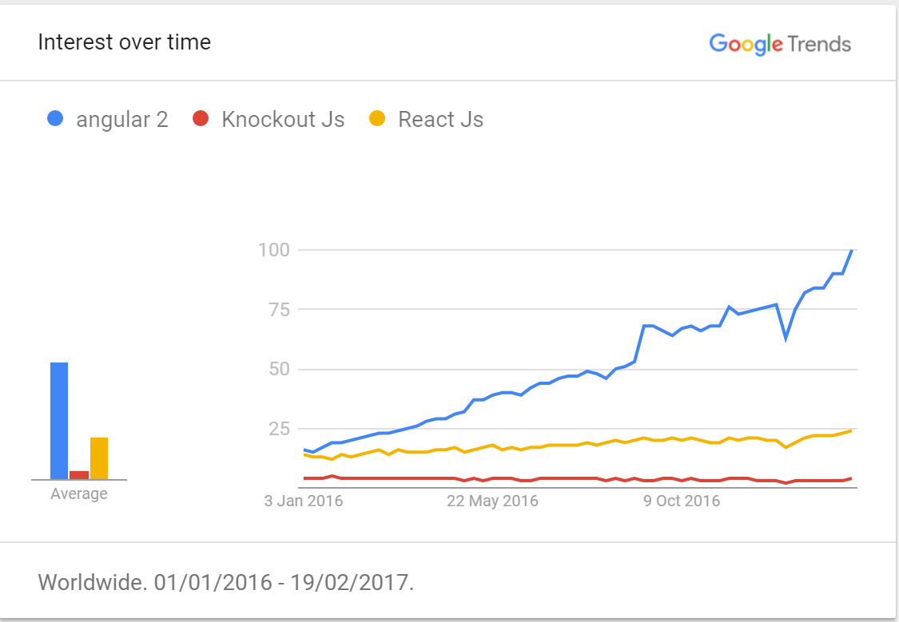
Angular 2 Popularity

Slide 6
Benefits of Angular 2 - Typescript
Compile time type checking, intellisense
export interface IListItem
{
someText: string;
someNumber: number;
someDate: number;
arrayOfStrings: string[];
}
export class AppComponent { listItems: IListItem[]; }

Slide 7
Typescript
Classes, Interfaces, Enums, Functions
Inheritance, Generics
Private, Public, Protected
Namespaces, Modules
Changes JavaScript for the better (more like C#)
Personally, Do not want to develop “vanilla” JavaScript ever again.
See more at
https://www.typescriptlang.org/

Slide 8
Benefits of Angular 2
Complete framework for developing apps
Components – building blocks for apps
Input, Output
Templates
Services (http and more)
Dependency Injection
Observables
Routing, Forms and Modules (skipping explanation of these in this presentation)
Get more information at
https://angular.io/docs/ts/latest/guide/

Slide 9
Benefits of Angular 2 - Components
Develop components – promotes clean testable code
import { Component } from '@angular/core';
@Component({
selector: 'my-app',
template: `<h1>Hello {{name}}</h1>`
})
export class AppComponent { name = 'Angular'; }

Slide 10
Benefits of Angular 2 - Events
@Component({
selector: 'my-app',
template: `<button (click)=“sayHello()”></button>`
})
export class AppComponent {
sayHello()
{
alert(“Hello);
}
}

Slide 11
Benefits of Angular 2 - Input
export class AppComponent {
@Input() name = 'Angular';
}
Can pass in data from the html
<my-app name=“some other name”></my-app>
Can also do binding
<my-app [name]=“myBoundVariable”></my-app>
Can also do two-way binding
<my-app [(name)]=“myBoundVariable”></my-app>

Slide 12
Benefits of Angular 2 - Output
export class AppComponent {
@Output() onSpecialEvent: EventEmitter<string> = new EventEmitter<string>();
specialEvent(value: string) {
this.onSpecialEvent.emit(value);
}
}
Can pass in data from the html
<my-app (onSpecialEvent)=“myCustomHandler($event)”></my-app>

Slide 13
Benefits of Angular 2 - Templates
Inline
File Reference (my preference)
@Component({
selector: 'my-app',
template: `
<h1>{{title}}</h1>
<h2>My favorite hero is: {{myHero}}</h2>
`})
@Component({
selector: "kip-enrolment-wizard",
templateUrl: "enrolmentwizard.html",
styleUrls: ["enrolmentwizard.css"],
})

Slide 14
Benefits of Angular 2 - Templates
<div [class.extra-sparkle]="isDelightful">
<div [style.width.px]="mySize">
<p>Employer: {{employer?.companyName}}</p>
Binds the presence of the CSS class extra-sparkle on the element to the truthiness of the expression isDelightful
Binds style property width to the result of expression mySize in pixels
The safe navigation operator (?) means that the employer field is optional and if undefined, the rest of the expression should be ignored.

Slide 15
Benefits of Angular 2 – Templates continued
<section *ngIf="showSection">
<li *ngFor="let item of list">
<div [ngSwitch]="conditionExpression"> <template [ngSwitchCase]="case1Exp">...</template> <template ngSwitchCase="case2LiteralString">...</template> <template ngSwitchDefault>...</template> </div>
See more at
https://angular.io/docs/ts/latest/guide/cheatsheet.html
Removes or recreates a portion of the DOM tree based on the showSection expression.
Turns the li element and its contents into a template, and uses that to instantiate a view for each item in list.
Conditionally swaps the contents of the div by selecting one of the embedded templates based on the current value of conditionExpression.

Slide 16
Benefits of Angular 2 – Services/Injectable
Can make helper service classes
These can provide a data access layer via http (these work really well with ASP NET core web api)
Can use observables (can subscribe to monitor changes)
someVariable.subscribe((changes)=>{});
Can use promises
soSomething(action).then((result)=>{});
Anything you can think of
These can be injected into your components
Makes it easy to mock and test

Slide 17
Benefits of Angular 2 – Services/Injectable
import { Injectable } from '@angular/core';
import { HEROES } from './mock-heroes';
@Injectable()
export class HeroService {
getHeroes() { return HEROES; }
}
------------------------
export class HeroListComponent {
heroes: Hero[];
constructor(heroService: HeroService) {
this.heroes = heroService.getHeroes();
}
}
import { Hero } from './hero';
export var HEROES: Hero[] = [
{ id: 11, isSecret: false, name: 'Mr. Nice' },
{ id: 12, isSecret: false, name: 'Narco' },
{ id: 13, isSecret: false, name: 'Bombasto' },
{ id: 14, isSecret: false, name: 'Celeritas' },
{ id: 15, isSecret: false, name: 'Magneta' },
{ id: 16, isSecret: false, name: 'RubberMan' },
{ id: 17, isSecret: false, name: 'Dynama' },
{ id: 18, isSecret: true, name: 'Dr IQ' },
{ id: 19, isSecret: true, name: 'Magma' },
{ id: 20, isSecret: true, name: 'Tornado' }
];

Slide 18
Benefits of Angular 2 – Observables & State
Observables
Uses RxJs to simplify asynchronous code
Observables, Promises and more
Almost a complete presentation in itself
State
Libraries like ngrx/store allow you to manage the entire state of your application simply
https://github.com/ngrx/store

Slide 19
Visual Studio Code
Use Visual Studio Code (free)
https://code.visualstudio.com/
Built in Git Hub integration
Plugins help write better code
TS Lint helps developers write better code – you can turn on/off rules to suit your coding style

Slide 20
Quick Code Demo
Showing NCG Demo

Slide 21
Compiling your Application
An Angular application consist largely of components and their HTML templates. Before the browser can render the application, the components and templates must be converted to executable JavaScript by the Angular compiler.
You can compile the app in the browser, at runtime, as the application loads, using the Just-in-Time (JIT) compiler.
JIT compilation incurs a runtime performance penalty. Views take longer to render because of the in-browser compilation step. The application is bigger because it includes the Angular compiler and a lot of library code that the application won't actually need. Bigger apps take longer to transmit and are slower to load.
Compilation can uncover many component-template binding errors. JIT compilation discovers them at runtime which is later than we'd like.

Slide 22
Ahead of Time Compilation
Faster rendering
With AOT, the browser downloads a pre-compiled version of the application. The browser loads executable code so it can render the application immediately, without waiting to compile the app first.
Fewer asynchronous requests
The compiler inlines external html templates and css style sheets within the application JavaScript, eliminating separate ajax requests for those source files.
Smaller Angular framework download size
There's no need to download the Angular compiler if the app is already compiled. The compiler is roughly half of Angular itself, so omitting it dramatically reduces the application payload.
Detect template errors earlier
The AOT compiler detects and reports template binding errors during the build step before users can see them.
Better security
AOT compiles HTML templates and components into JavaScript files long before they are served to the client. With no templates to read and no risky client-side HTML or JavaScript evaluation, there are fewer opportunities for injection attacks.

Slide 23
Treeshaking – Making application smaller
Tree shaking is the ability to remove any code that we are not actually using in our application from the final bundle. It's one of the most effective techniques to reduce the footprint of an application.
You may think “all my code is being used!”
Third party libraries
Redundant code etc
Done using Webpack 2.
Can be included as part of the build process
Very easily done using……

Slide 24
Angular Command Line Interface
Use angular cli (command line interface)
https://github.com/angular/angular-cli
Automatic change detection, can just change code while you are developing and your browser will automatically be refreshed
Built in commands to create components, directives etc
Run karma tests
Run full project linting
Automates build process
Ahead of time compilation
Copies all the files you need to make deployment easy
Joins all the files together and “tree-shakes” your code to make it a small as possible
Automates css/js compression

Slide 25
Angular Cli Getting Started
npm install –g angular-cli
ng new new-app
cd new-app
ng serve
Other Commands
ng generate …. (components, routes, services)
ng build -- prod
ng build -- dev

Slide 26
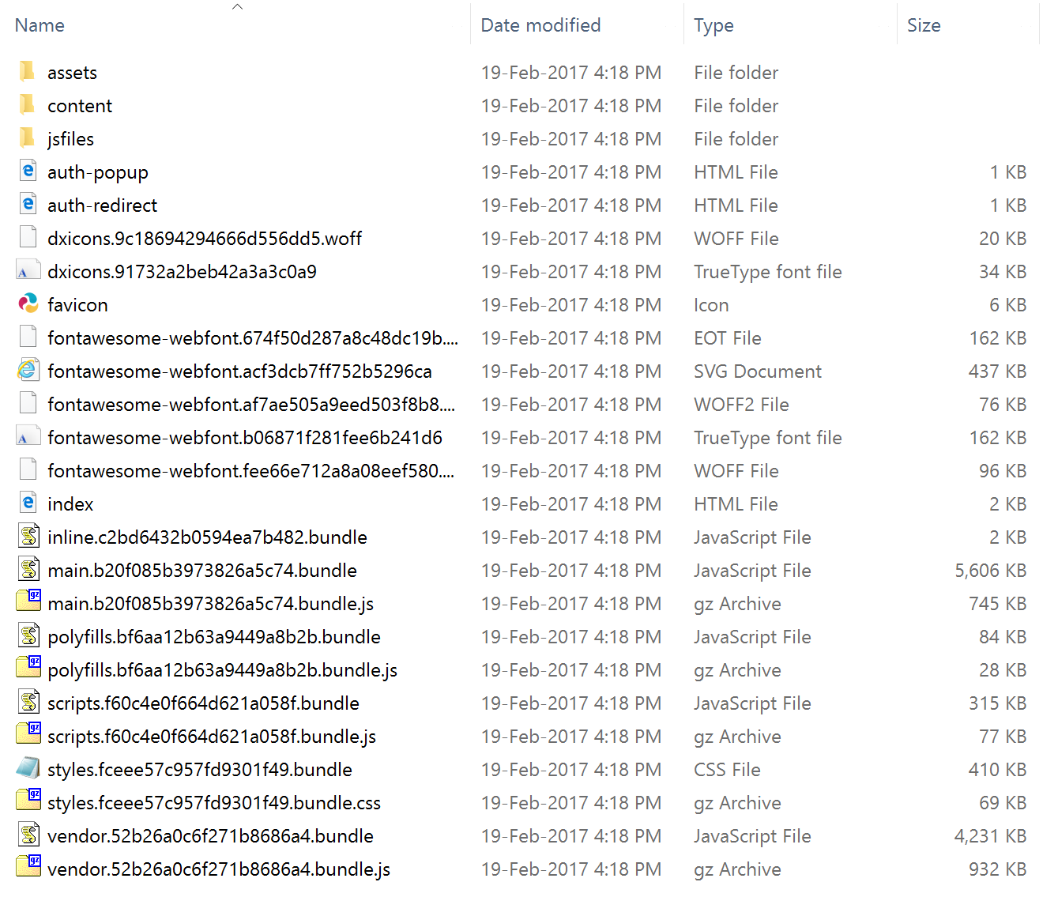
Angular Cli build output
Creates file with guid names based on if content has changed
Makes caching easy
Splits up scripts (your code, reference libraries etc)
Can make it include files as required
Copy to server and it will just work

Slide 27
Component Frameworks
Many component vendors
Telerik - http://www.telerik.com/kendo-angular-ui/
Wijmo - http://wijmo.com/angular2/
Dev Extreme - https://www.npmjs.com/package/devextreme-angular
Material - https://material.angular.io/
Most are still a work in progress
We are currently using Dev Extreme (as they are reusing their old code base, they are more complete)

Slide 28
Quick Demo of Application
Demonstrate
Speed
Translation
Services
Security

Slide 29
Questions?
Presentation will be up on my site
www.petermessenger.com
Looking for employment
Want to work on Angular 2 Project?
Come and see me, Kip McGrath is hiring.

